Slide 1
Employee Data Analysis using Excel
STUDENT NAME:P.KARNEESH
REGISTER NO:122200717
NM ID: E62F81990EA0C11B9334F906AD86F91C
DEPARTMENT:COMMERCE[B.COM]
COLLEGE:ASAN MEMORIAL COLLEGE OF ARTS AND SCIENCE

Slide 2
PROJECT TITLE
EMPLOYEE DATA ANALYSIS USING EXCEL

Slide 3


AGENDA
Problem Statement
Project Overview
End Users
Our Solution and Proposition
Dataset Description
Modelling Approach
Results and Discussion
Conclusion
3/21/2024 Annual Review

Slide 4

PROBLEM STATEMENT
Analyze Data in Excel empowers you to understand your data through natural language queries that allow you to ask questions about your data without having to write complicated formulas.

Slide 5

PROJECT OVERVIEW
Data collection and analysis tools are defined as a series of charts, maps, and diagrams designed to collect, interpret, and present data for a wide range of applications and industries.

Slide 6
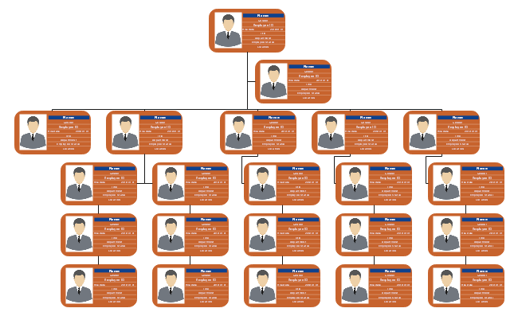

WHO ARE THE END USERS?

Slide 7

OUR SOLUTION AND ITS VALUE PROPOSITION
FILTERING
COLOURING
CONDITIONAL FORMATING
PIVOT TABLE
SLICER

Slide 8
Dataset Description
EMPLOYEE DATASET COLLECT FROM IBM DASHBOARD
THERE ARE 26 FEATURES IN THE DATA SET
WE COLLECT ONLY 8 FEATURES IN THE EMPLOYEE DATA SET
1ST WE COLLECT EMPLOYEE ID IN THE DATA SET
2ND ONE IS FIRST NAME
3RD IS SUPERVISOR
4TH ONE IS BUSINESS UNIT
5TH ONE IS PAYZONE
6TH IS DEPARTMENT TYPE
NEXT ONE IS STATE
AND THE LAST ONE WE COLLECT FROM THE DATASET IS
GENDER

Slide 9
MODELLING
DATA COLLECTION
DATA SET DOWNLOAD FROM EDUNET DASH BOARD
EMPLOYEE PERFORMANCE ANALYSIS USING EXCEL
FEATURES COLLECTING
THERE ARE 26 FEATURES IN THE DATA
EMPLOYEE ID, FIRST NAME,LAST NAME,SUPERVISOR,EXIT DATE,ETC…
IN THIS 26 FEATURES WE COLLECT ONLY 8 FEATURES IN THE DATA SET
EMOLOYEE ID, FIRST NAME,SUPERVISOR,BUSINESS UNIT,PAYZONE,DEPARTMENT TYPE,STATE AND GENDER
9

Slide 10
DATA CLEANING
IN THE DATA CLEANING WE ALSO USE CONDITIONAL FORMATING
IDENTIFYING THE MISSING VALUES
USING CONDITIONAL FORMATING AND HIGHLIGHTING BY COLOURS
REMOVE THOSE BLANK VALUES WITH USING FILTER
SUMMARIZING(PIVOT TABLE)
COLLECT THE DATA FROM THE EXCEL SHEET
SUMMARIZE THE VALUE USING PIVOT TABLE
A PARTICULAR DATA IS SET TO BE IN THE ROW AND FILTER
AND WE USE SLICER TO SELECT THE FIELD TO USE FOR FILTERING LIKE PAYZONE,ETC…

Slide 11
RESULTS
11

Slide 12
conclusion
IN CONCLUSION ,ANALYSING EMPLOYEE DATA USING EXCEL PROVIDES A ROBUST FRAME WORK
FOR GAINING VALUABLE INSIGHTS INTO WORK FORCE DINAMICS AND OPERATIONAL EFFICIENCY.
EXCELS DIVERSE ARRAY OF TOOLS AND FUNCTIONS,SUCH AS PIVOT TABLE ALLOWS FOR COMPREHENSIVE
DATA MANIPULATION AND VISUALIZATION .

